Slide 1

Kick-Off Block C
Monday
6
February 2023
Block C – Data Modelling

Slide 2
Agenda
Kick-off: 9:00-9:30
Notifications
Introduction
Creative Brief
Knowledge Modules
Municipality Briefing: 9:30 – 10:15?
A day in the life of: 10:30 – 12:00
Notes:
Content:
- Introduction (Dean, 5 min)
- Cognition/Data Management (Bram, 5 min)
- Computer Vision (Irene, 5/10 min)
- Robotics (Dean, 5/10 min)

Slide 3

Notifications
Block C medals:
Bronze:
Silver:
Gold:

Slide 4

1. Introduction
Block D
Deployment & Evaluation phase of the
CRIPS-DM lifecyle
DataLab preparation: Microsoft Forms

Slide 5
2. Creative Brief

Slide 6
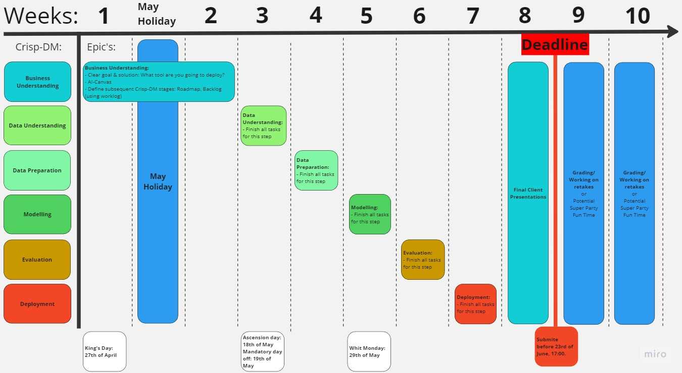
2.1 Project Timeline

Slide 7
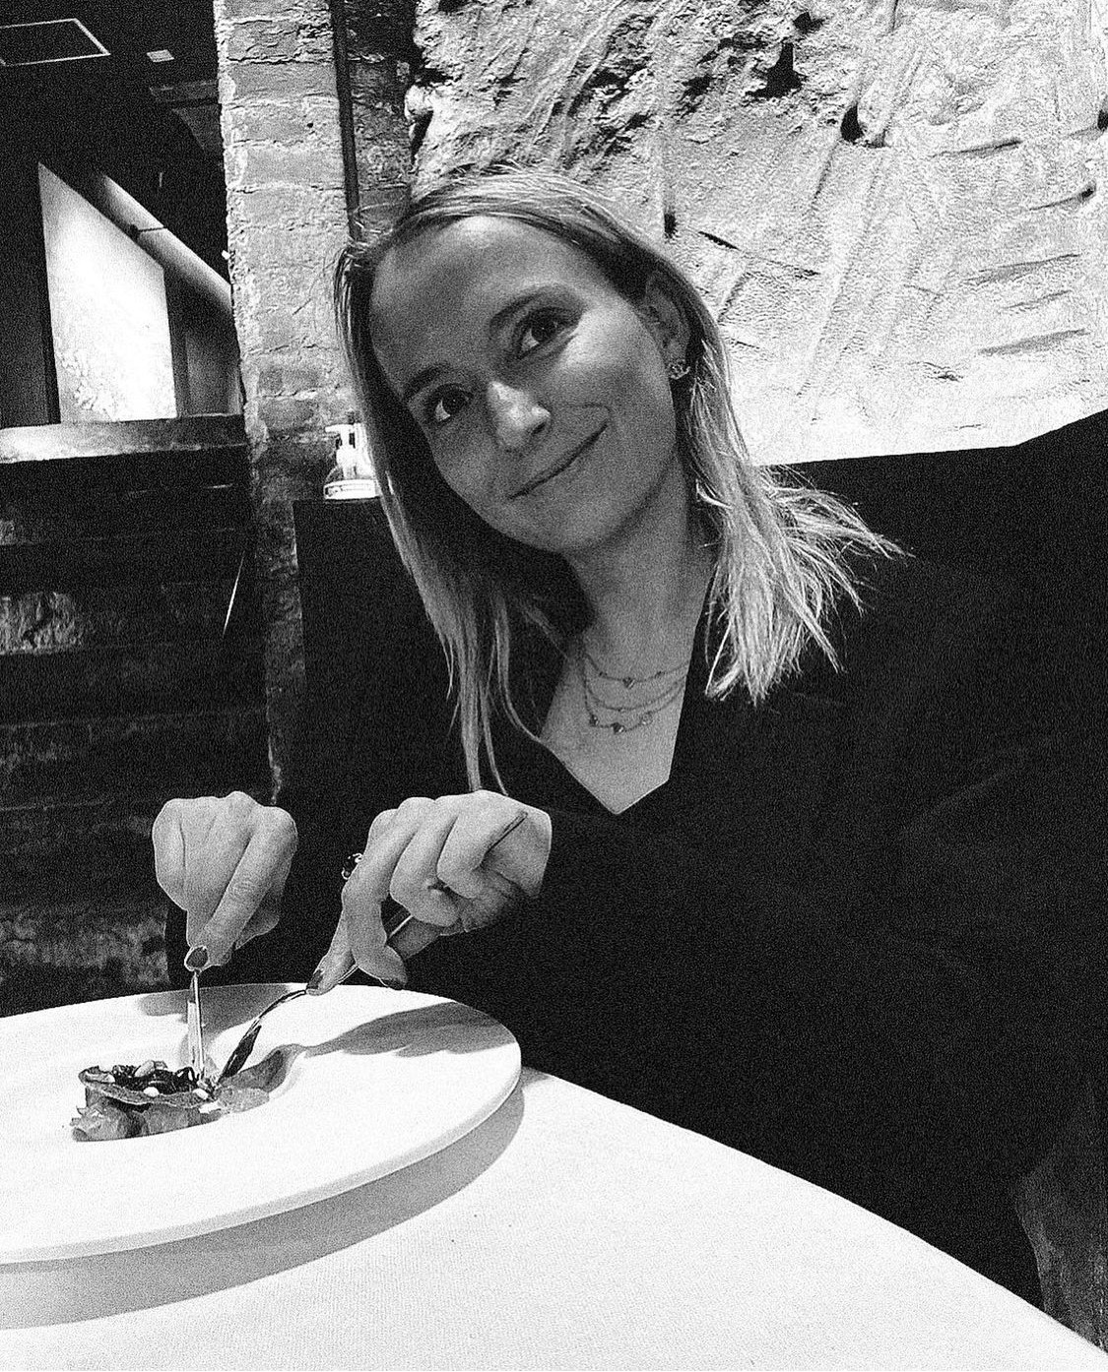
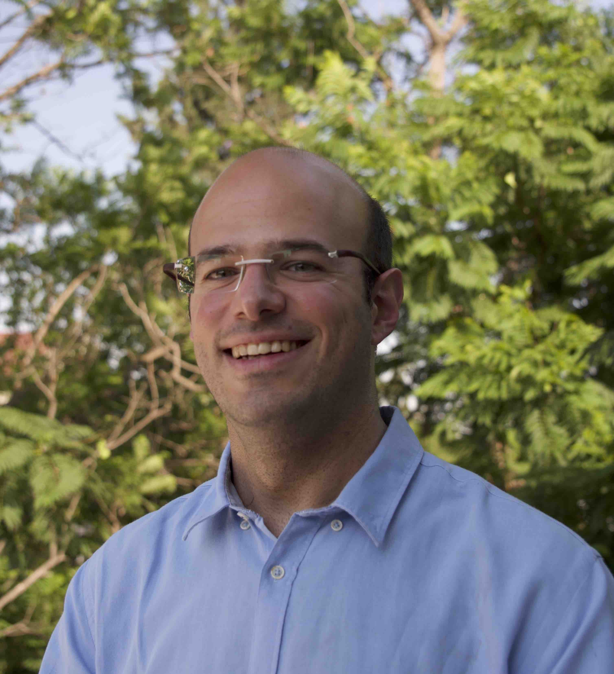

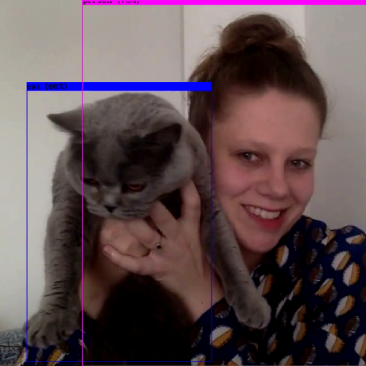

3. Knowledge Modules
Weeks 2-5
Week 1
Week 6
Weeks 7-8

Slide 8
3.1 Legal

Slide 9
3.2 SQL

Slide 10
3.3 Agile Project Management

Slide 11
3.4 Deploying in Python

Slide 12
Wrap-up
Final Client Presentation:

Slide 13
Plagiarism
Don’t copy one another’s work
It’s fine if you use ChatGPT, Quilbot etc.
But we have a right to know how you used AI
You have to reference where and mention how you used AI assistance
Confer with your mentor if you’re unsure
Regulation is being discussed within BUas

Slide 14


Thank you for your attention!
Questions, comments, advice, ideas…?

